Slide 1
National Acute Hospital Review Inpatients and Outpatients
January 2023

Slide 2
Table of Contents
Topic | Slide No.
Inpatient
IP & DC Discharges | 3
AVLOS Tables | 11
Day of Surgery Admission Rate | 18
7-Day & 28-Day Readmission % | 19
Outpatients
Outpatient Activity | 24
2

Slide 3
Inpatients inpatient and daycase discharges
3

Slide 4
Comment
The following series of Inpatient and Daycase charts are based on HIPE data.
This data is generally two months behind the focus month of this monthly report.
Due to lags in coding of HIPE records, the latest reported month may be incomplete.
4

Slide 5
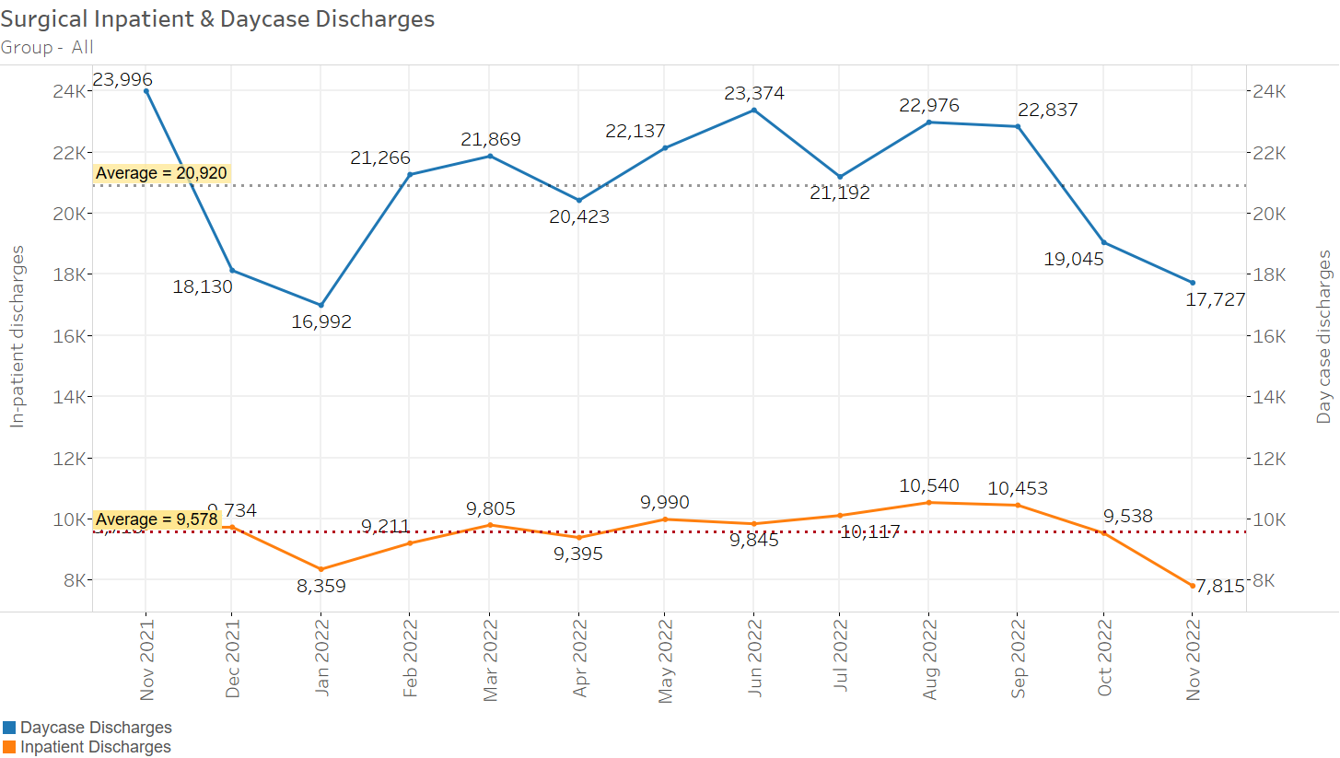
National Surgical IP & DC Discharges
Discharges in latest month may be understated due to incomplete data.
5

Slide 6
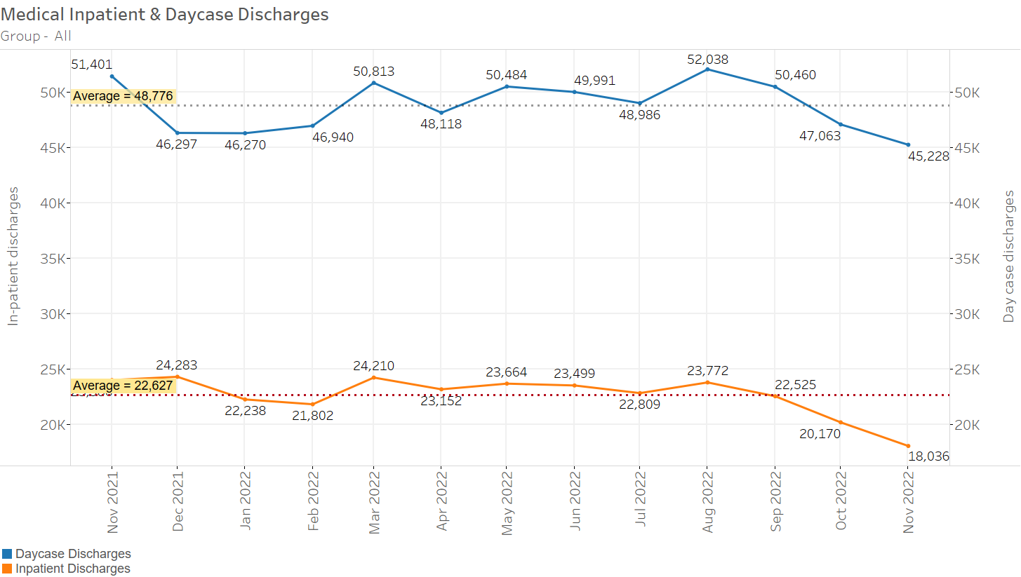
National Medical IP & DC Discharges
Discharges in latest month may be understated due to incomplete data.
6

Slide 7
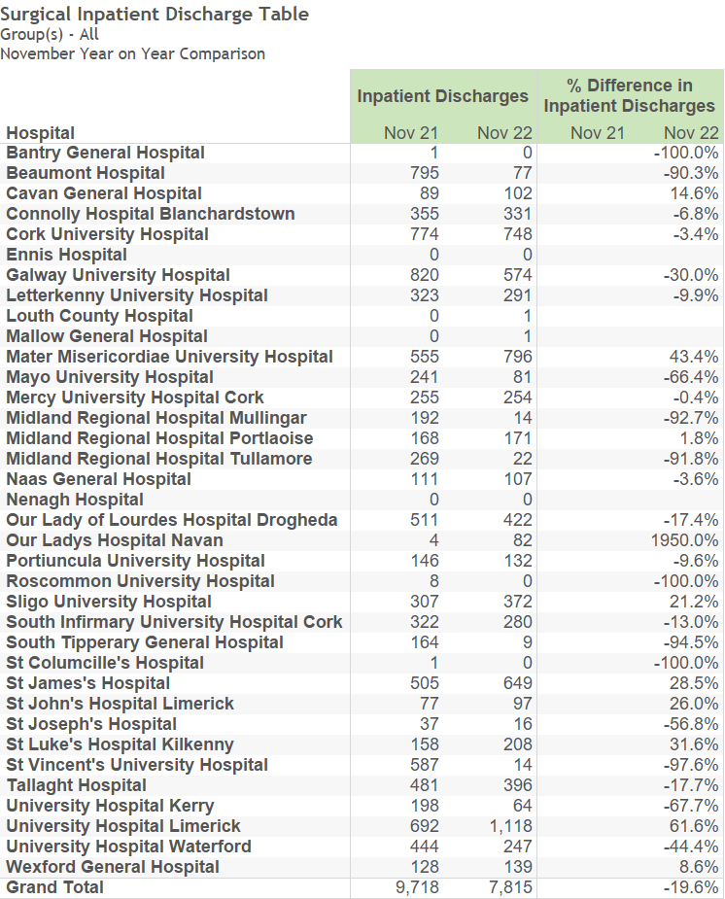
Surgical Inpatient Discharges
Discharges in latest month may be understated due to incomplete data.
7

Slide 8
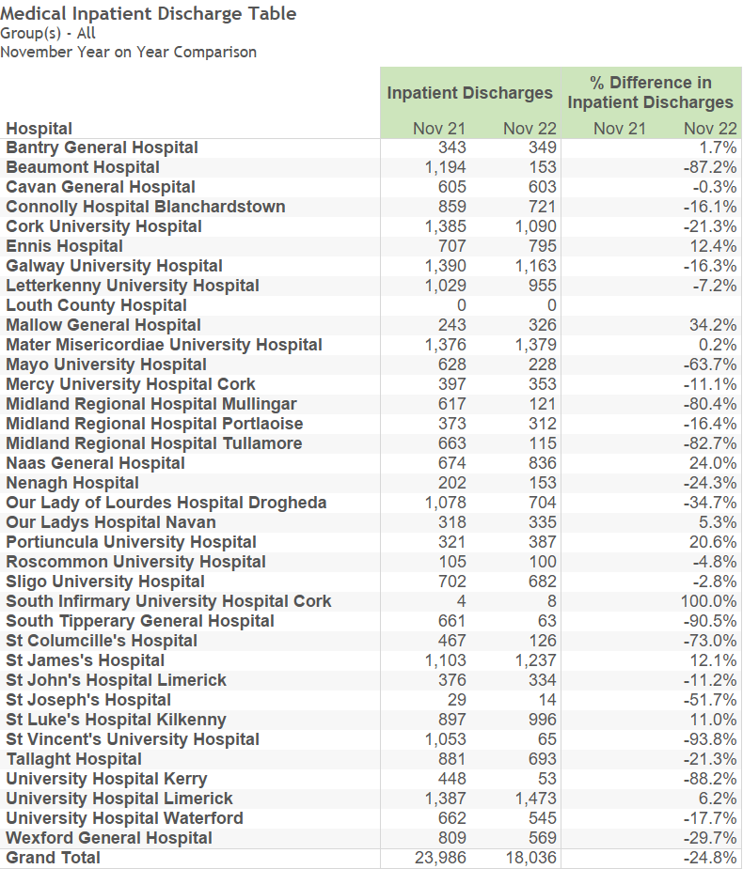
Medical Inpatient Discharges
Discharges in latest month may be understated due to incomplete data.
8

Slide 9
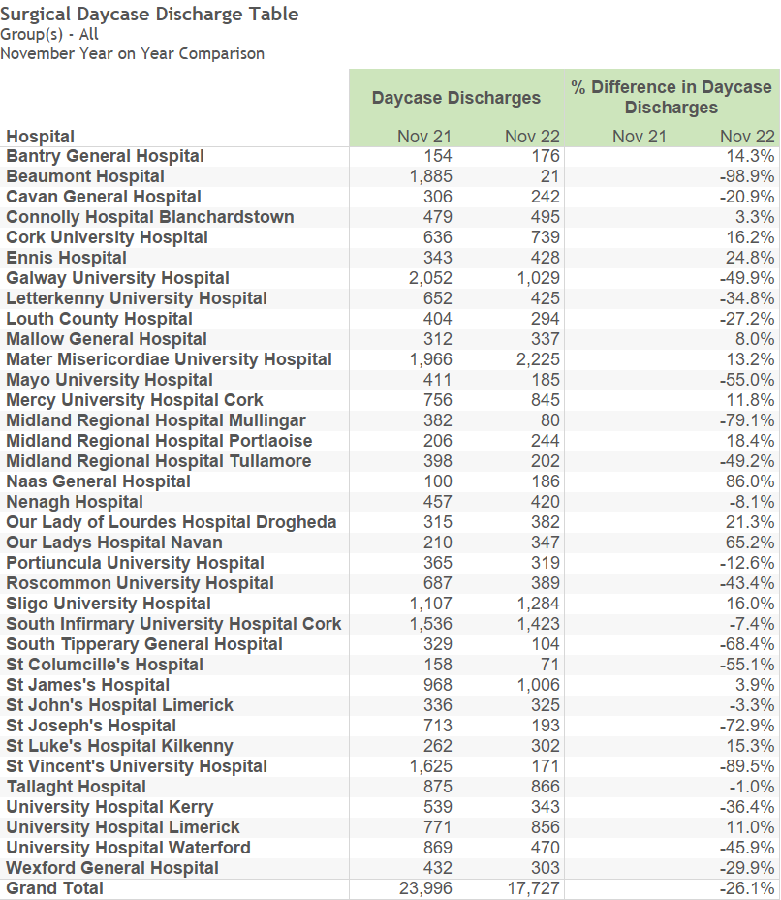
Surgical Daycase Discharges
Discharges in latest month may be understated due to incomplete data.
9

Slide 10
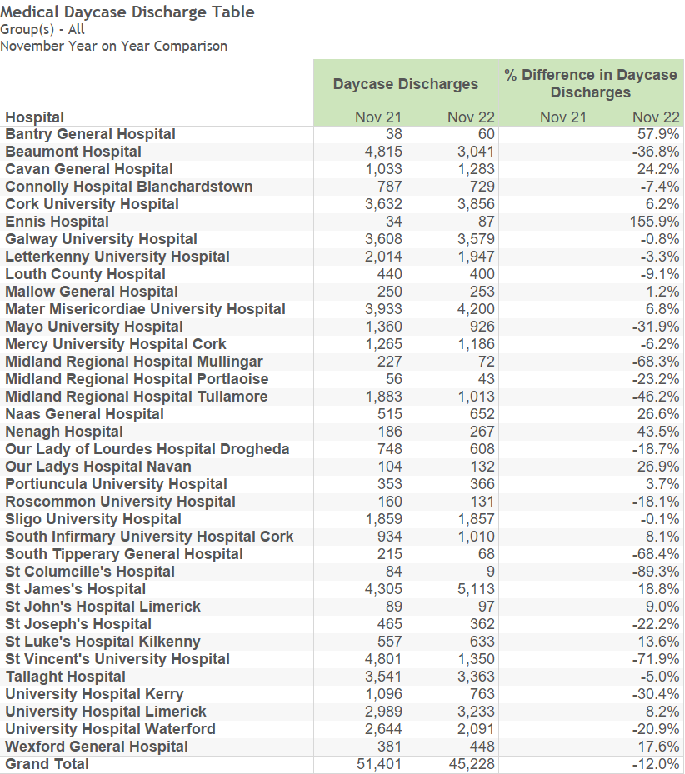
Medical Daycase Discharges
Discharges in latest month may be understated due to incomplete data.
10

Slide 11
Inpatients AVLOS Tables
Average Length of Stay (AvLOS)
AvLOS in latest month may be understated due to incomplete data.
Please note that the reported AvLOS is rounded to one decimal place, however, % difference is calculated using the unrounded figure.
11

Slide 12
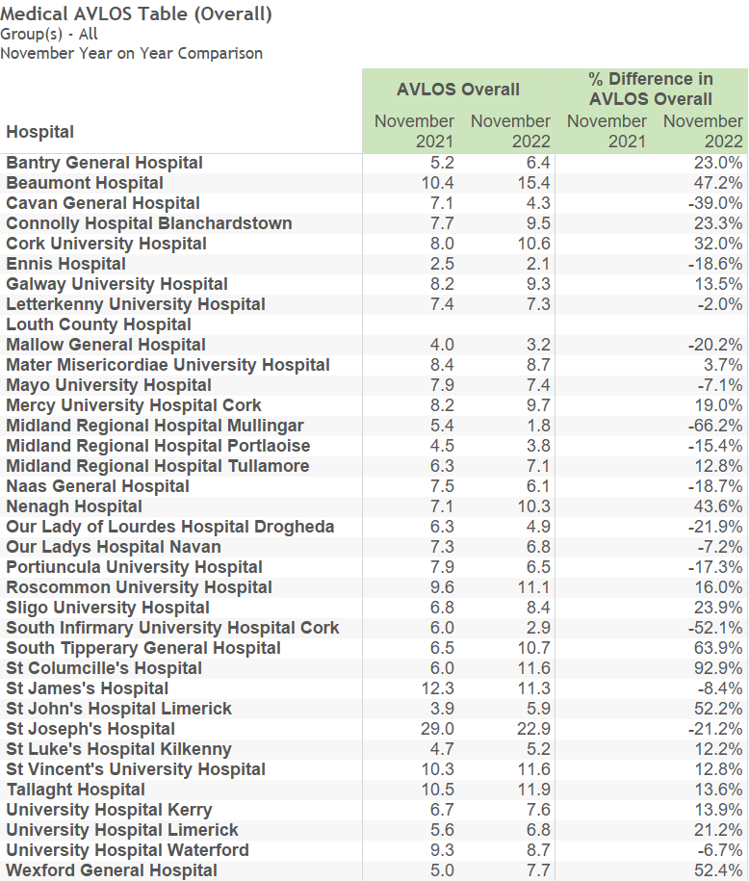
Medical AVLOS (Overall) 2022 v 2021
12

Slide 13
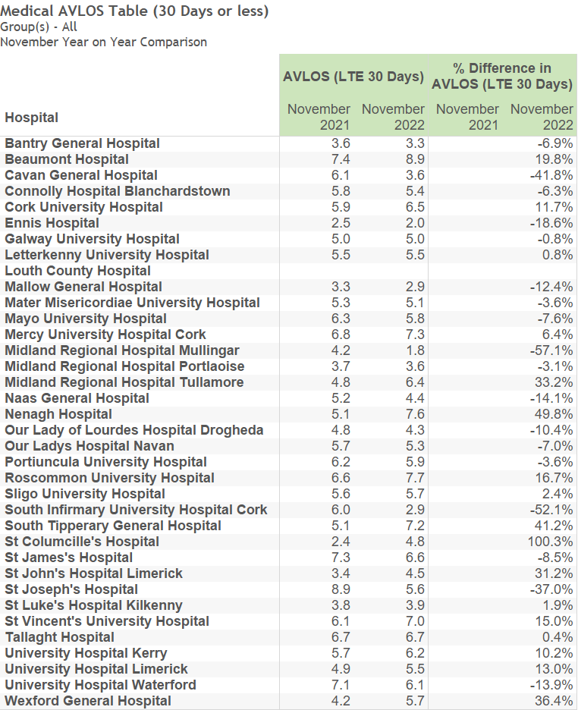
Medical AVLOS (30 Day Stay or less) 2022 v 2021
13

Slide 14
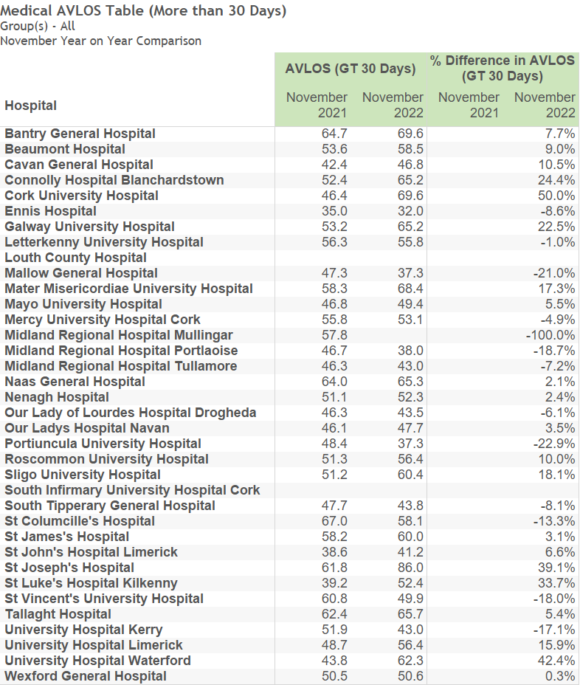
Medical AVLOS (More than 30 Days stay) 2022 v 2021
14

Slide 15
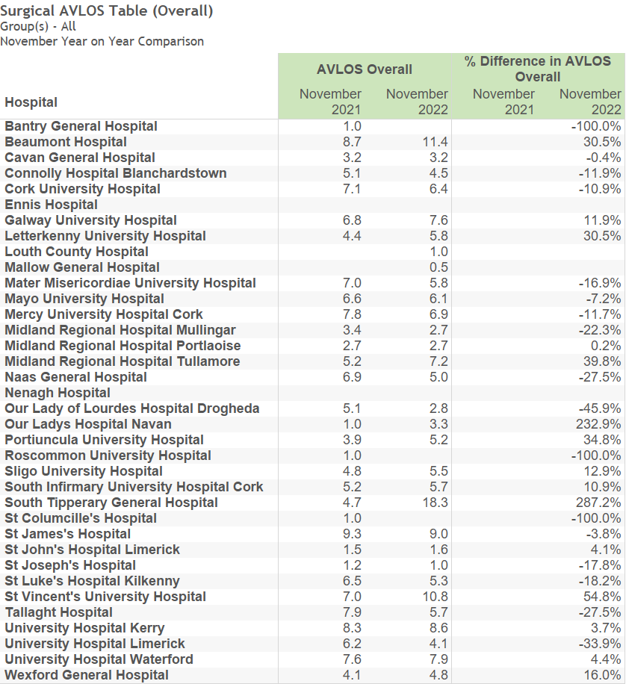
Surgical AVLOS (Overall) 2022 v 2021
15

Slide 16
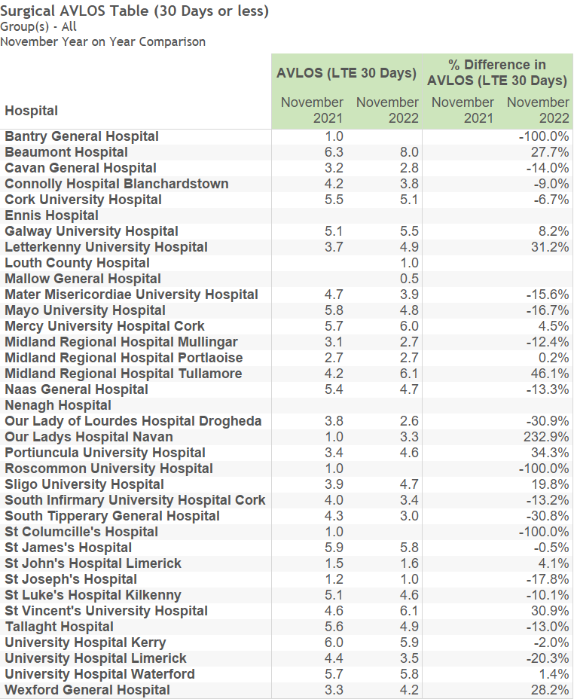
Surgical AVLOS (30 Day Stay or less) 2022 v 2021
16

Slide 17
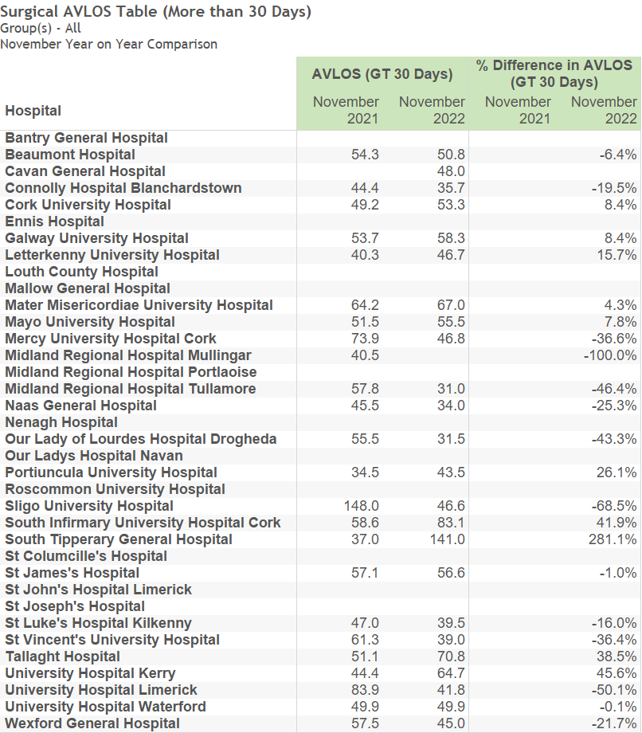
Surgical AVLOS (More than 30 Days Stay) 2022 v 2021
17

Slide 18
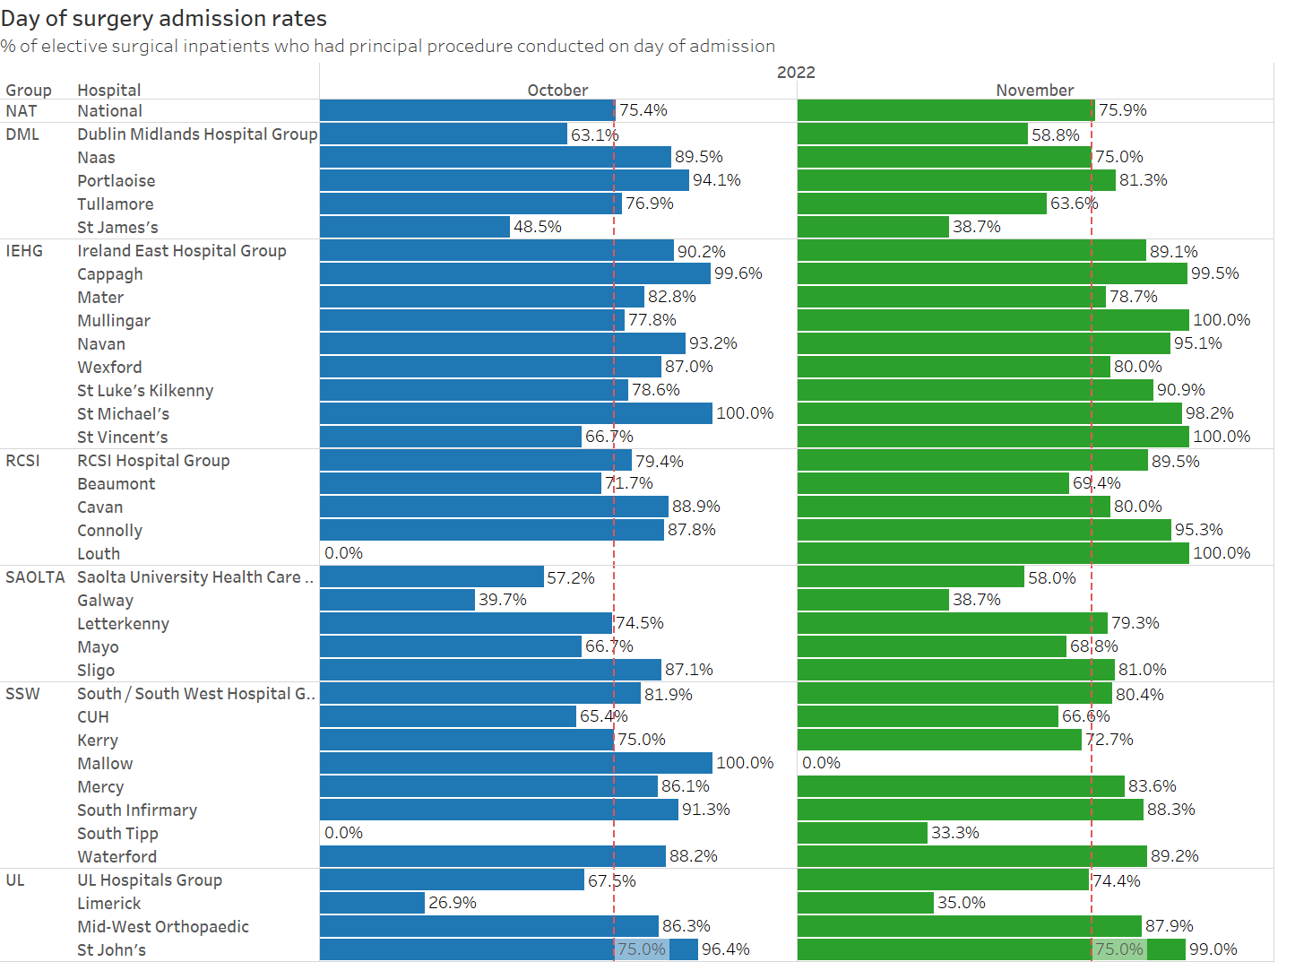
DOSA Rates Per Site
18

Slide 19
Inpatients 7 Day & 30 day ReAdmission Percentages.
The N-day readmission rate is calculated as the fraction of emergency discharges in the reporting month of whom were readmitted to the same hospital in less than N days. It should be noted that until HIPE is updated with data for the next reporting month there will only be a portion of the actual count of readmissions for the current reporting month in the records as the patient is not recorded in HIPE until they are discharged, e.g. if a patient was discharged on 2019-01-28 and then readmitted as an emergency on 2019-02-03, there will be no information on the readmission until HIPE is updated for February 2019 and the reported readmission rate will be the fraction of January 2019 discharges readmitted before 2019-02-01 00:00:00; consequently the readmission rates for the latest reporting month are substantially understated.
19

Slide 20
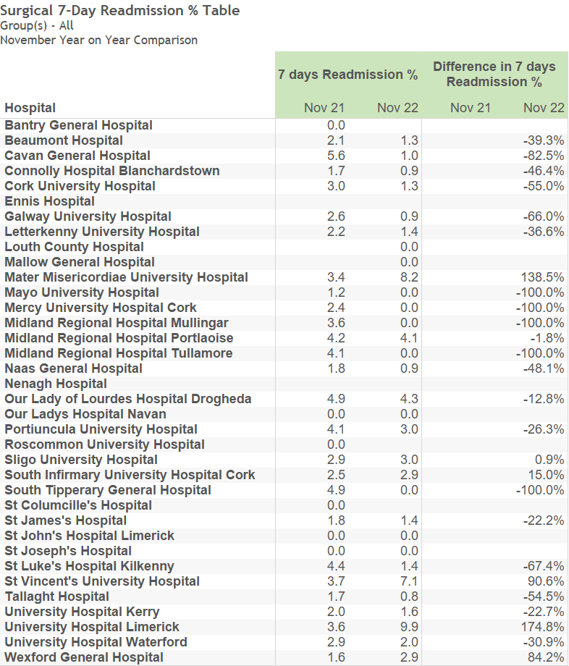
Surgical
7-Day Readmission %
Readmission rates in latest month may be understated due to incomplete data.
20

Slide 21
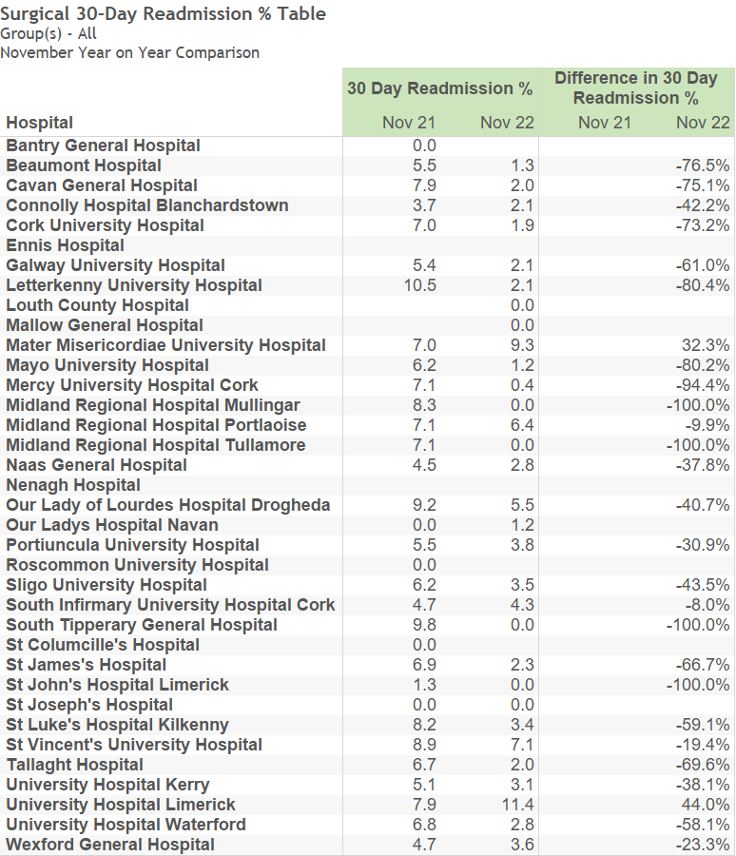
Surgical 30-Day Readmission %
Readmission rates in latest month may be understated due to incomplete data.
21

Slide 22
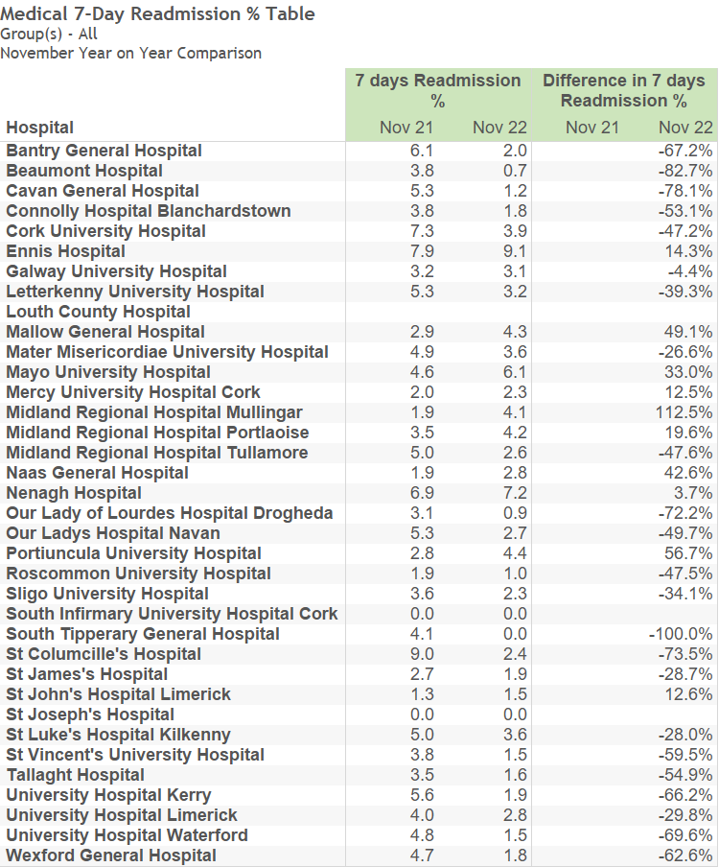
Medical 7-Day Readmission %
Readmission rates in latest month may be understated due to incomplete data.
22

Slide 23
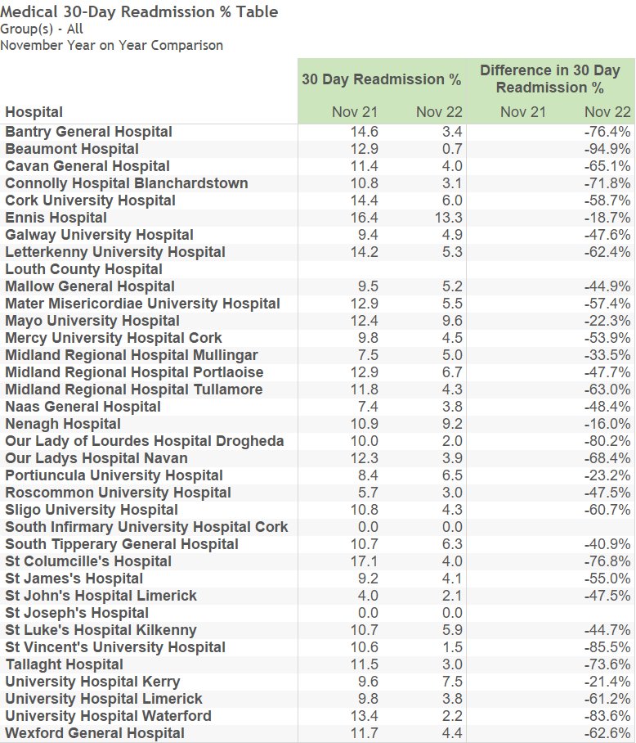
Medical 30-Day Readmission %
Readmission rates in latest month may be understated due to incomplete data.
23

Slide 24
Outpatients Activity
24

Slide 25
Comment
The data for Outpatient Activity is generally one month behind the focus month of this monthly report.
25

Slide 26
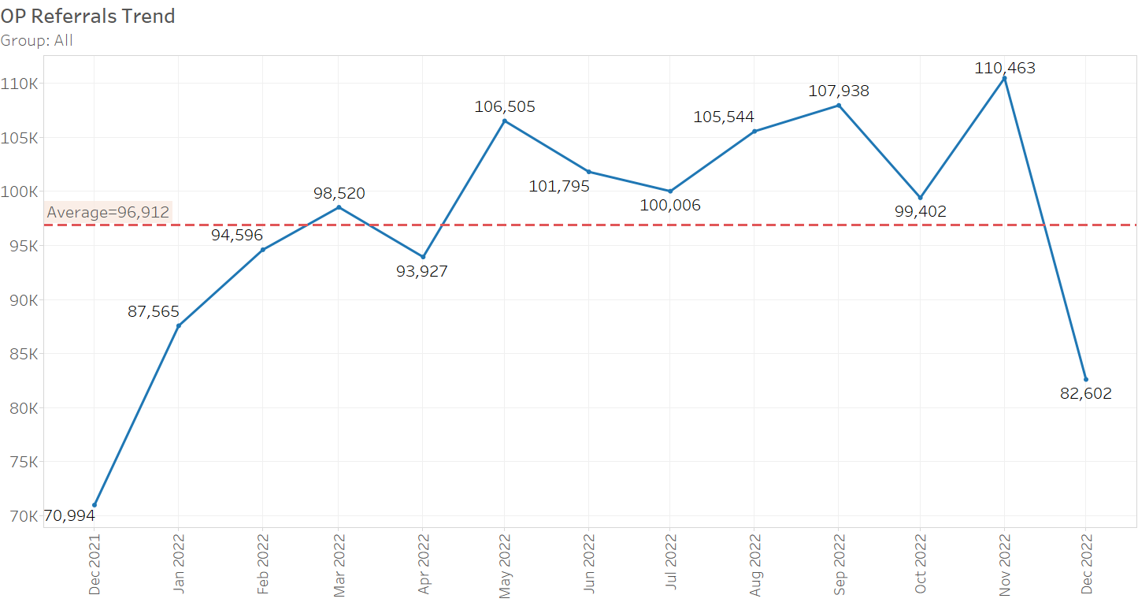
Monthly New Referrals
26

Slide 27
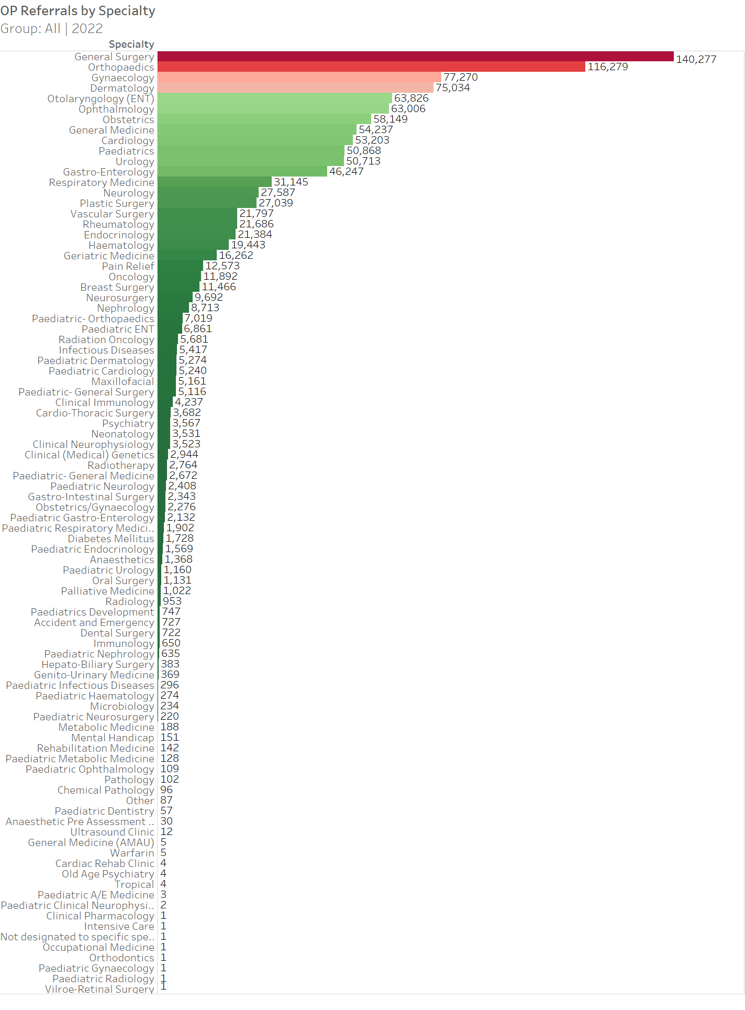
Year to Date Referrals by Specialty
27

Slide 28
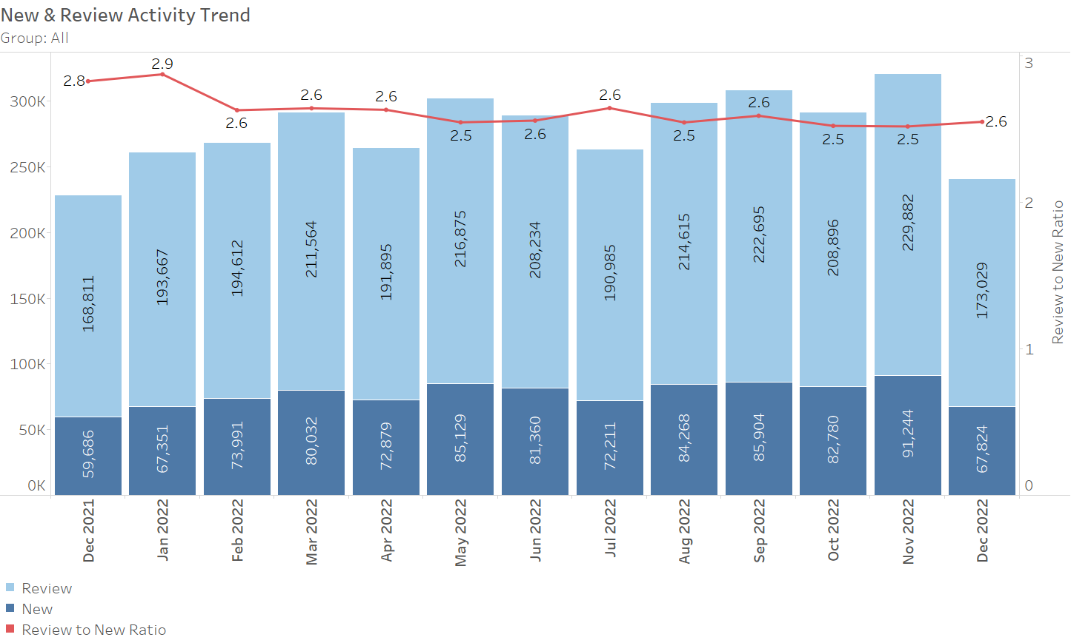
OP New & Review Appointments
28

Slide 29
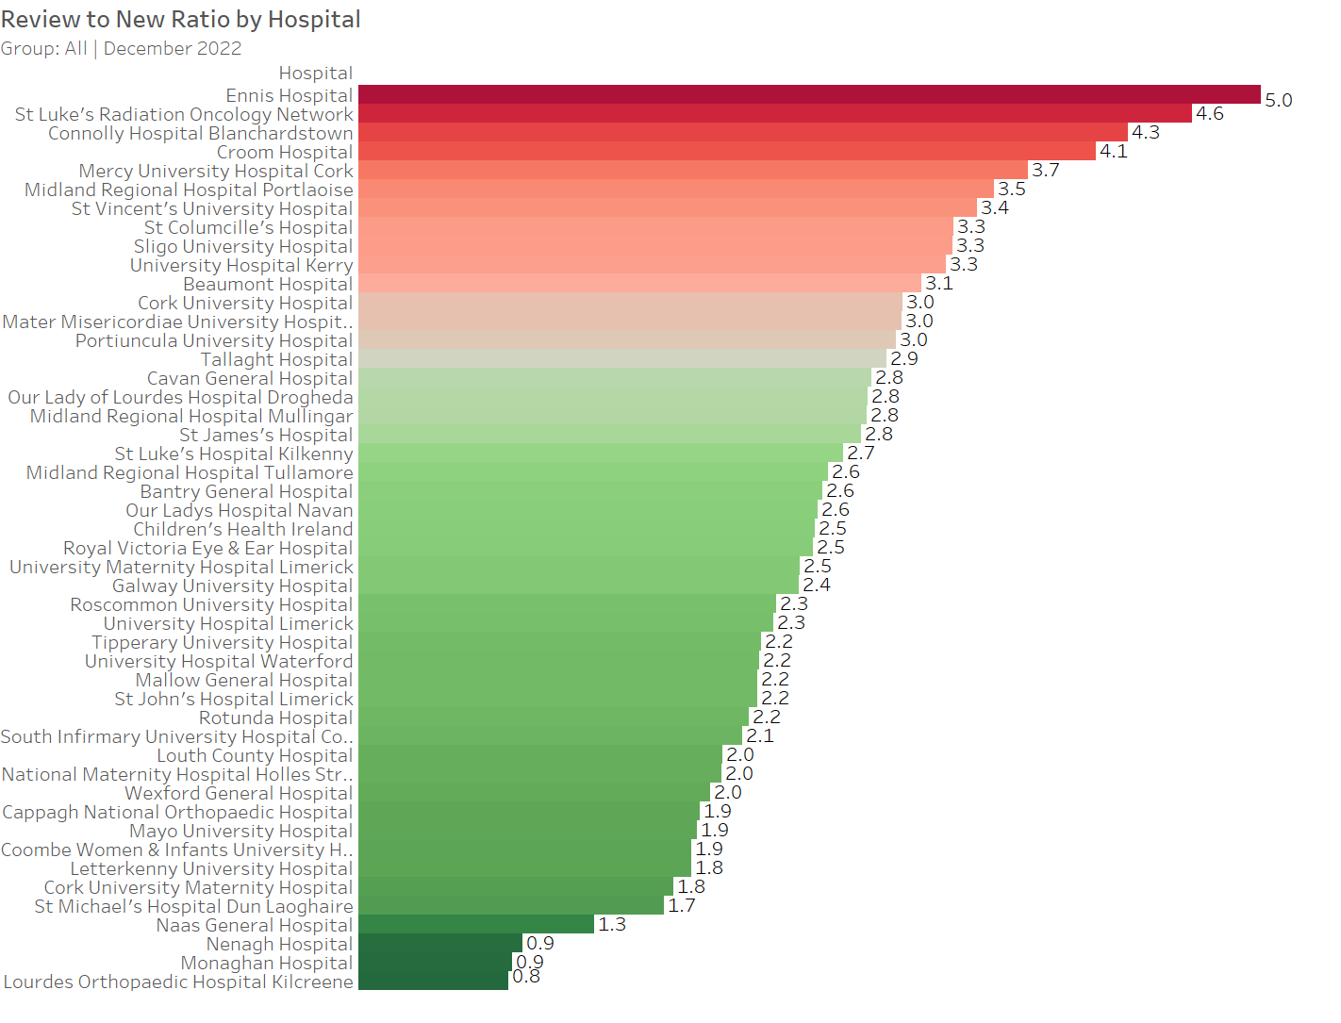
Review to New Ratio by Hospital
29

Slide 30
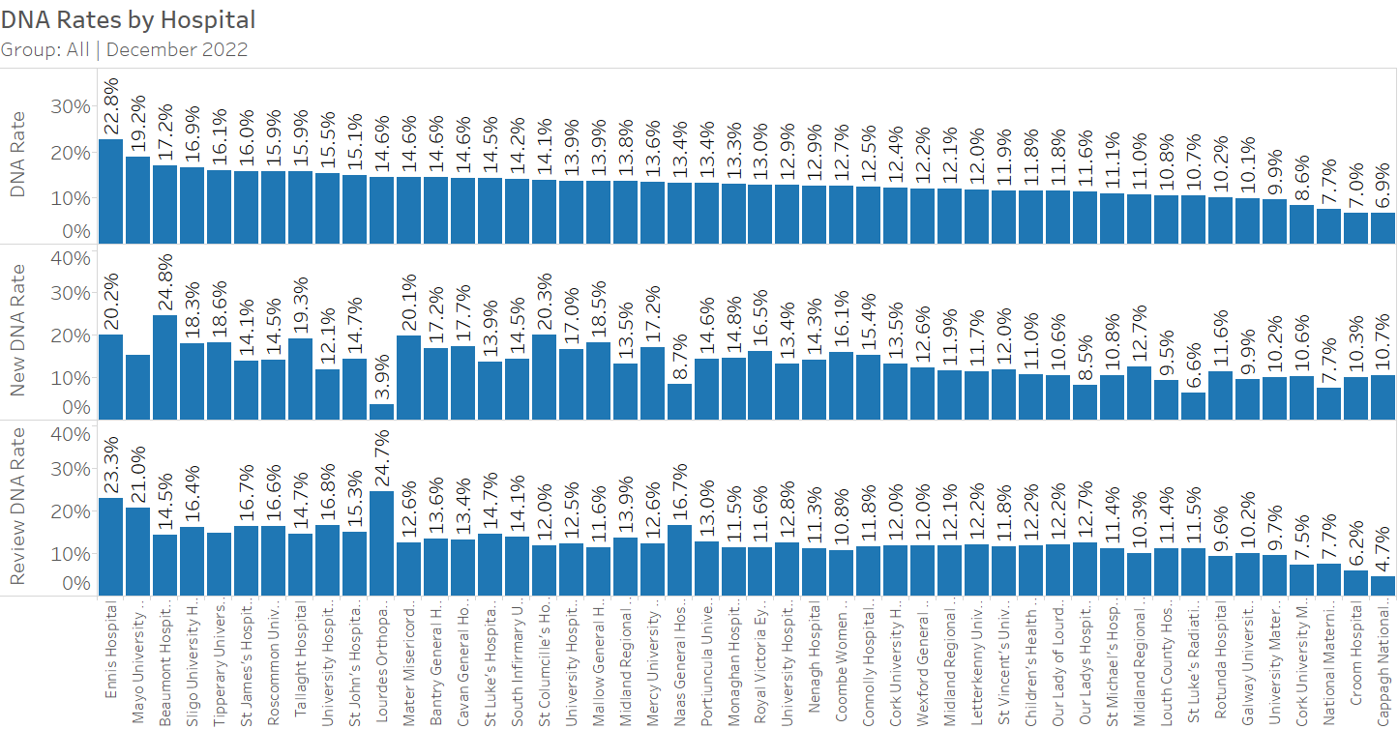
DNA Rates by Hospital
30

